Slide 1
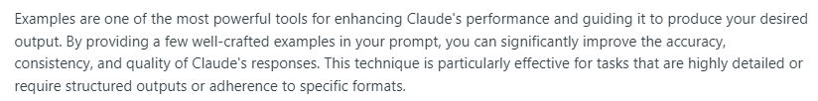
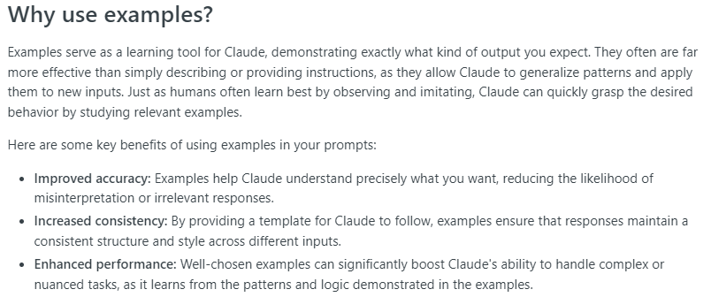
Use Examples
Notes:
https://docs.anthropic.com/claude/docs/use-examples

Slide 2
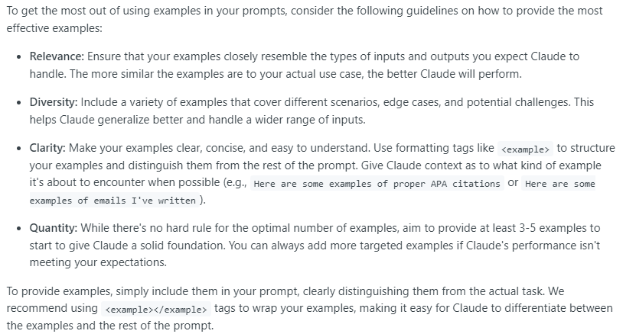
Examples: Creating Effective Examples

Slide 3
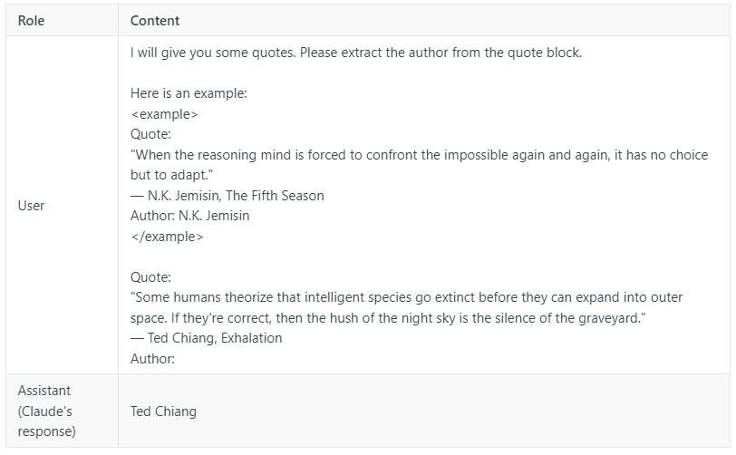
Examples: simple examples

Slide 4
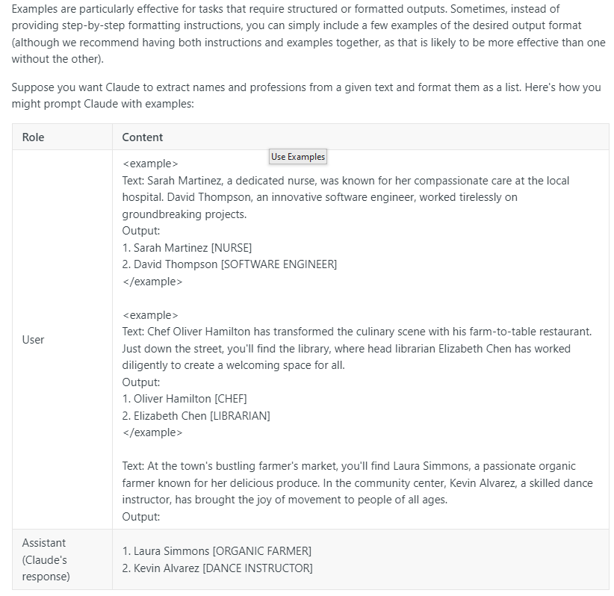
Examples: Structured Output

Slide 5
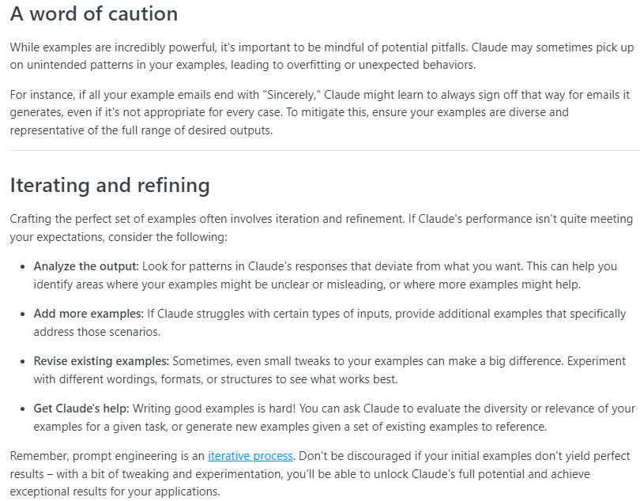
Examples: Tips for success

Slide 6
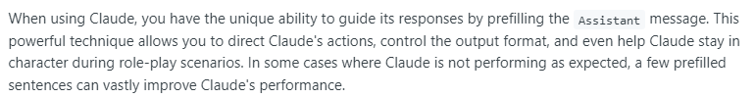
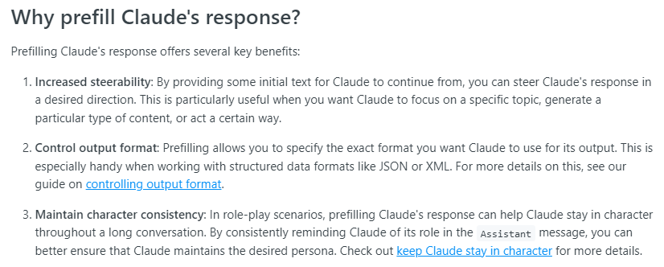
Prefill the response
Notes:
https://docs.anthropic.com/claude/docs/prefill-claudes-response

Slide 7
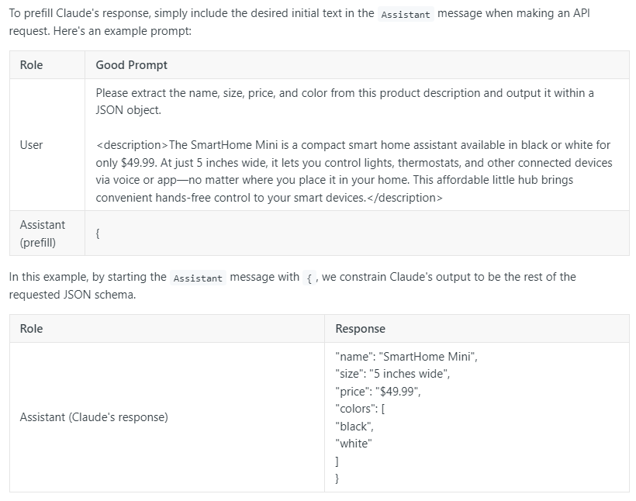
Prefill: Example

Slide 8
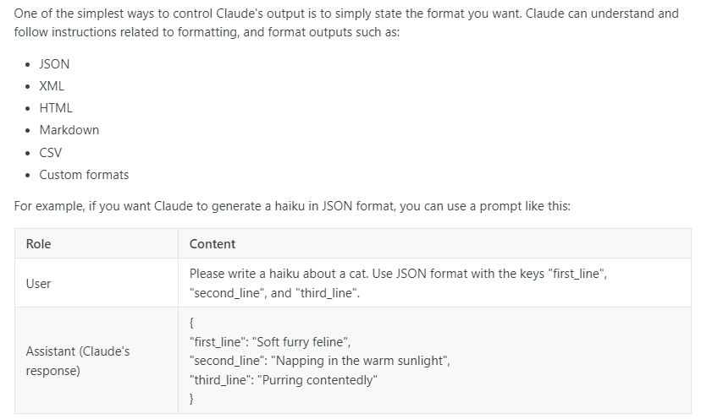
Control Output Format
Notes:
https://docs.anthropic.com/claude/docs/control-output-format

Slide 9
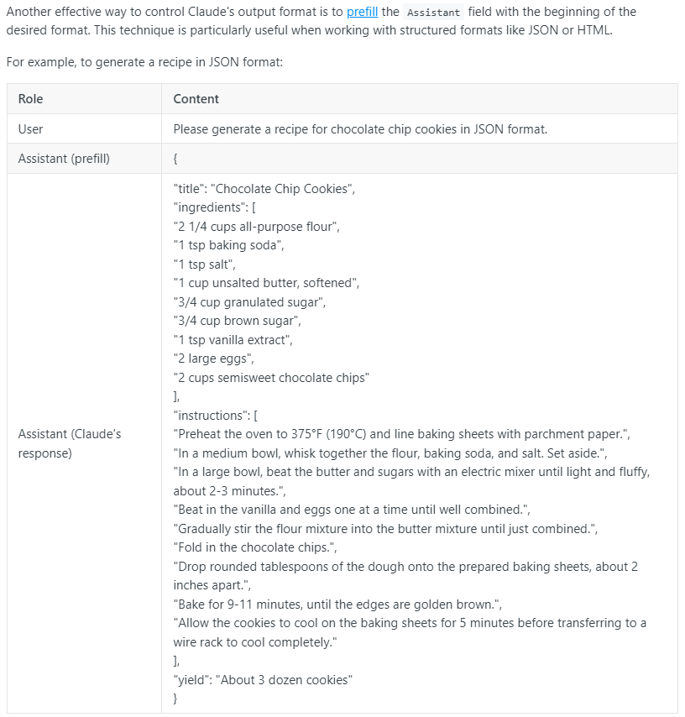
Control Output format: prefilling

Slide 10
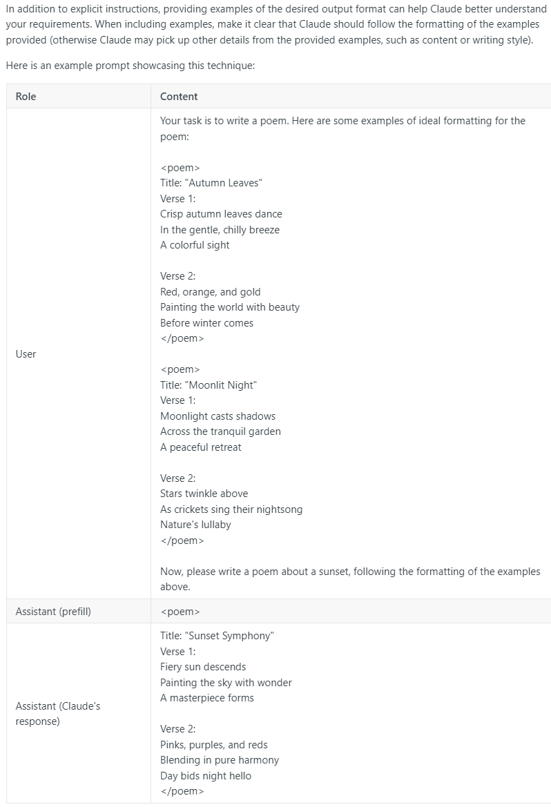
Control output Format: give examples

